Slide 1
DeepEIT: Deep Image Prior Enabled Electrical Impedance Tomography
Liu et al., 2023
IEEE Transactions on Pattern Analysis and Machine Intelligence

Slide 2
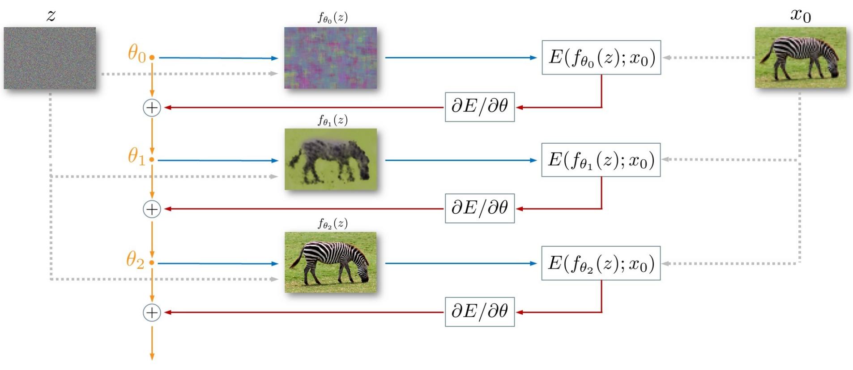
Deep Image Prior (DIP)
Ulyanov et al., 2020
Solve classic inverse problems with no training data
Image denoising, inpainting, super-resolution

Slide 3
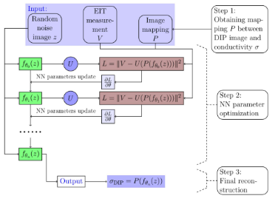

DeepEIT Framework

Slide 4
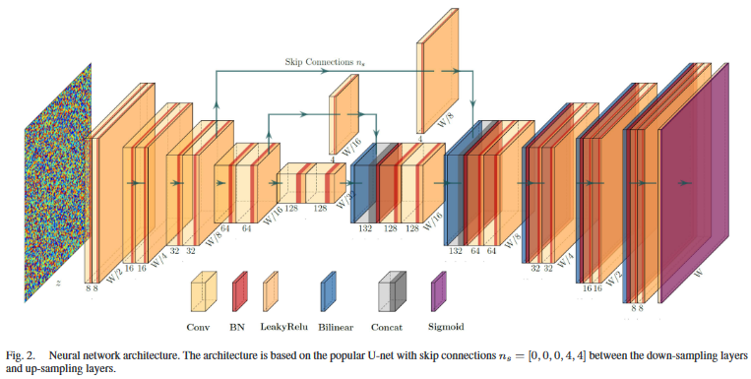
DeepEIT Architecture

Slide 5
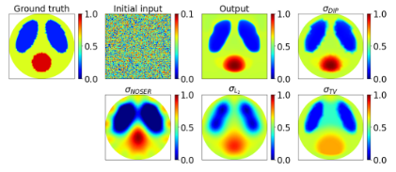
Case 1: Simulation
Notes:
Adjacent Patterns
Separate inverse mesh to not have inverse crime
Gaussian noise of SNR=60 dB
Case 1: results of the simulated heart-and-lungs phantom. Initial input: random noise image z; Output: fˆ θ(z); σDIP : DeepEIT based reconstruction, i.e., σDIP = P (fˆ θ(z)). σNOSER: NOSER based reconstruction; σL2 and σTV : reference estimations using smoothness prior and total variation, respectively.

Slide 6
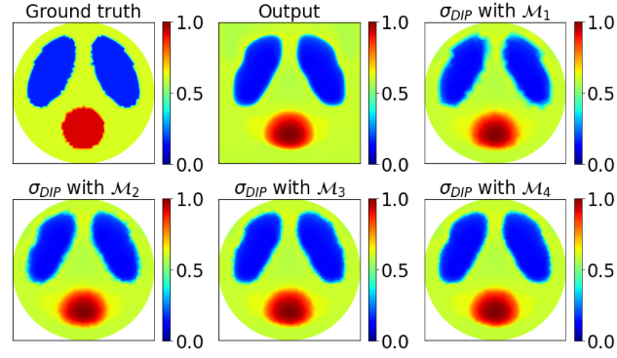
Increasing Inverse Mesh Densities

Slide 7
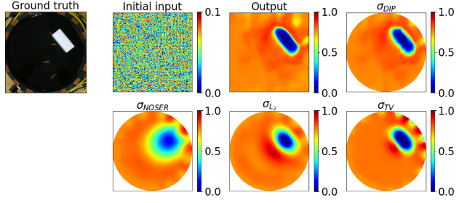
Case 2: Experimental

Slide 8
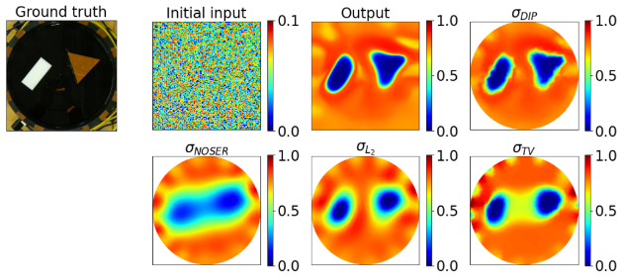
Case 3: Experimental

Slide 9
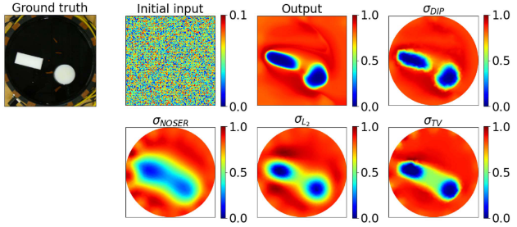
Case 4: Experimental

Slide 10
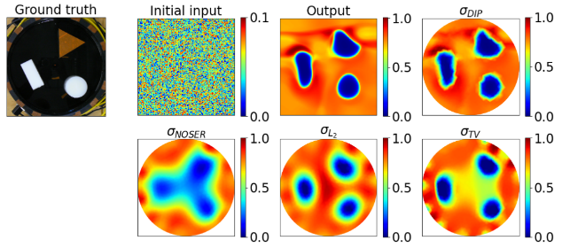
Case 5: Experimental

Slide 11
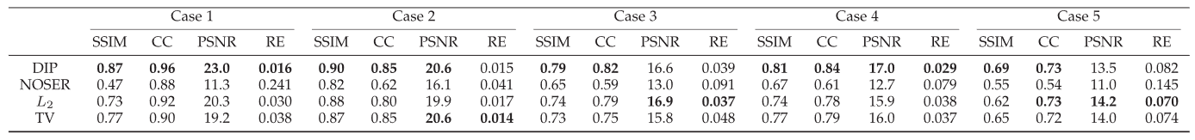
Metrics

Slide 12
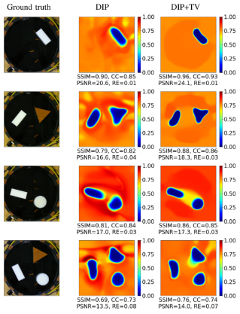
DeepEIT + TV

Slide 13
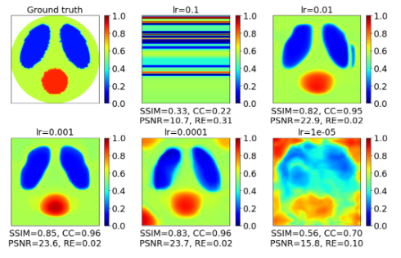
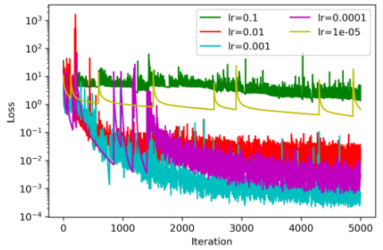
Learning Rate Ablation Study

Slide 14
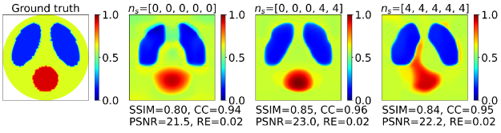
Skip Connection Ablation Study

Slide 15
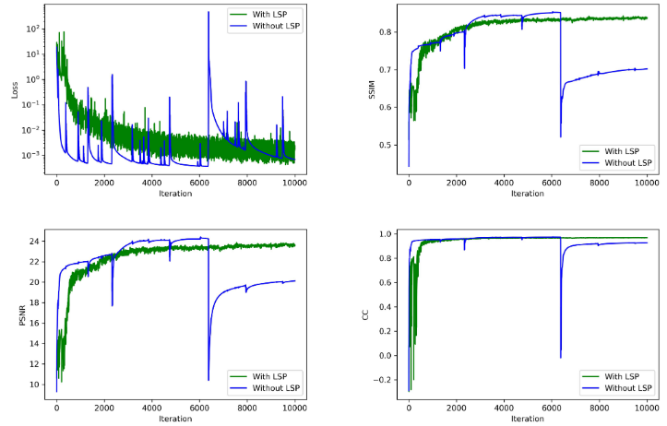

Loss Stabilization Procedure
Is $\frac{Loss_{i}−Loss_{i−1}}{Loss_{i}}>0.01$?

Slide 16
Further Work
Time
1.03 seconds per iteration, reported 5000 iterations
Currently only for absolute images
Linearization of observation model – speed up reconstruction
Include reference image as an input
Having a pre-trained “starter” network

Slide 17
Strengths Weaknesses
No training data needed
(unsupervised learning)
Good performance
Well shown ablation studies
No clinical data
Not real time
More noise sensitivity analysis

